Slide 1
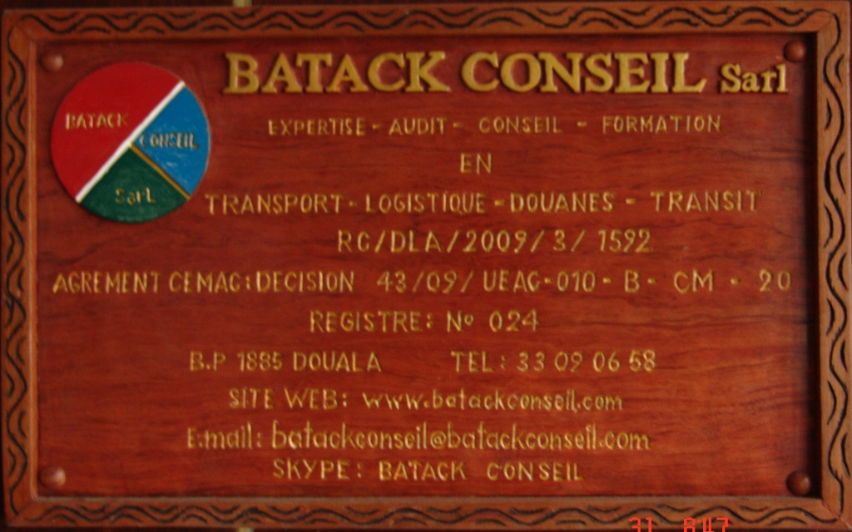

Slide 2
BATACK CONSEIL Sarl
On the hill-side of ‘Centenaire’, Akwa - Douala
P.O Box 1885 DOUALA - CAMEROON
Tel : (237) 33.09.06.58
Email : batackconseil@batackconseil.com
web Site :http/www.batackconseil.com
Skype : batackconseil

Slide 3
PROMOTERS
Dr Roger Roland PFEIFFER
Luxembourgeois
Transport Economist
International Consultant
based in Berlin (RFA)
TCHAPA TCHOUAWOU
Cameroonian
Retired Super-Scale Senior Inspector of Customs
CEMAC Accredited Expert in Customs Matters
International Consultant
Based in Douala (CMR)

Slide 4
Vision
AT
THE SERVICE OF
THE COMPANY
AND
IN DEFENCE
OF ENTERPRENUERSHIP

Slide 5
AREAS OF COMPETENCE
COUNSELING IN MANAGEMENT
COUNSELING IN ORGANSATION
INSTALLATION LOGISTIC DESIGNS
NUMERICAL DOCUMENTATION AND
ON-LINE HELP-DESK
AUDIT
COMPANY RESTRUCTURING
FEASIBILITY
STUDIES
TRAINING

Slide 6
PUBLICATIONS
VADE MECUM
OF CUSTOMS BUREAU CHIEF AND OF THE CHIEF OF SECTOR
VADE MECUM
OF THE CUSTOMS AGENT, TRANSIT AGENT, TRANSPORT AGENT , AGENTS OF THE MARITIME PROFESSIONS AND PARAMARITIMES
INPERSPECTIVE
VADE MECUM
OF THE USER OF CUSTOMS SERVICES

Slide 7
TRAINING
CUSTOMS
TRANSIT
LOGISTICS
TRANSPORTATION
AFIELDS

Slide 8
TRAINING
TYPES OF TRAINING
FONDAMENTAL
TAILORED TO SUIT PURPOSE

Slide 9
FONDAMENTAL TRAINING
MANAGEMENT OF CUSTOMS LITIGATION PROCEDURES
MANAGEMENT OF EXPORT PROCEDURES
MANAGEMENT OF TRANSIT PROCEDURES
MANAGEMENT OF CUSTOMS
INVESTIGATIONS AND CONTROLS
MANAGEMENT OF PROCEDURES
MANAGEMENT OF IMPORT PROCEDURES
PROCEDURES

Slide 10
TAILORED TRAINING
PROCES CHAINS
PREPARATION OF CONTROLS
FILING OF FILES

Slide 11
POTFOLIO
CIMENCAM
SICALIA
BANQUE MONDIALE
UNION EUROPEENNE
COOPERATION FRANCAISE
ORANGE CAMEROUN
AES SONEL
CNUCED
BAT
DHL
HERMES
IBC
PERENCO

Slide 12
TEAM OF SENIOR EXPERTS IN
FINANCE
TRANSPORT
LOGISTICS
CUSTOMS
TRANSIT

Slide 13
The team of batack consulting firm
N° | NAME | RANK
1 | TCHAPA TCHOUAWOU | Customs expert– Managing Associate
2 | PFEIFFER Rolland Roger | Expert in Transport and Logistics – Associate
3 | SIGHOMNWE S. Joseph | CEMAC accredited Customs Expert – Consultant
4 | NKENGAFAC Stephen | CEMAC accredited Customs Expert – Consultant
5 | MBINAMOU NYAMSI | CEMAC accredited Customs Expert – Consultant
6 | TCHOUAWOU TCHAPA | Junior Auditor
7 | NOSHYE MBOPDA Thierry | Accountant

Slide 14
joint venture firm
T.P.G.P Sarl
PARIS - FRANCE
A.G.I.S Sarl
AFRICAN GROUP
FOR INTERNATIONAL STUDIES
YAOUNDE- CAMEROUN
G.T.S Sarl
GLOBAL TECHNOLOGIES
& SERVICES
DOUALA - CAMEROUN
TRAVAILLER PLUS
ET GAGNER PLUS

